Slide 1
Null Object
A major ’if’ killer ☺
CS, AU
Henrik Bærbak Christensen

Slide 2
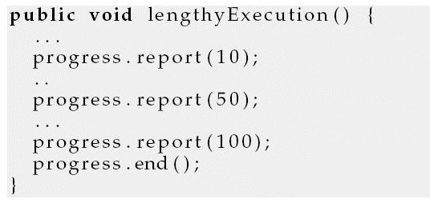
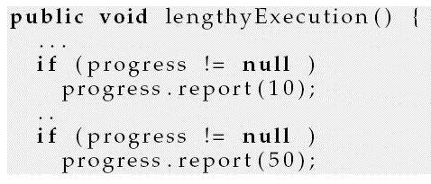
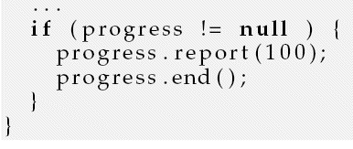
Motivation
Automated testing of lengthy operation, but…
  To improve usability we show a progress bar ☹
Solution?
CS, AU
Henrik Bærbak Christensen

Slide 3
A Solution
The problem
  Representing ‘absence’ by null
Can be solved by
  Representing ‘absence’ with a special absence object
The null object…
CS, AU
Henrik Bærbak Christensen

Slide 4
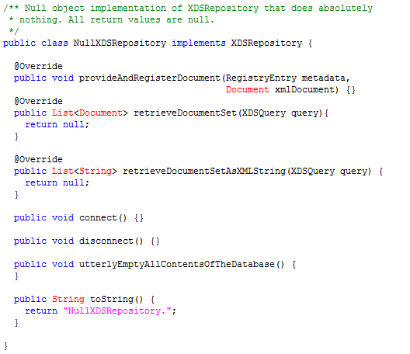
Example: Net4Care
TDD of AppServer which stores documents in XDS.b (database system)
  SOAP messages containing ebXML payload sent to web service on remote machine that connects a MicroSoft SQLServer 2008!
But but, I am only
interested in testing
internal stuff...
CS, AU
Henrik Bærbak Christensen

Slide 5
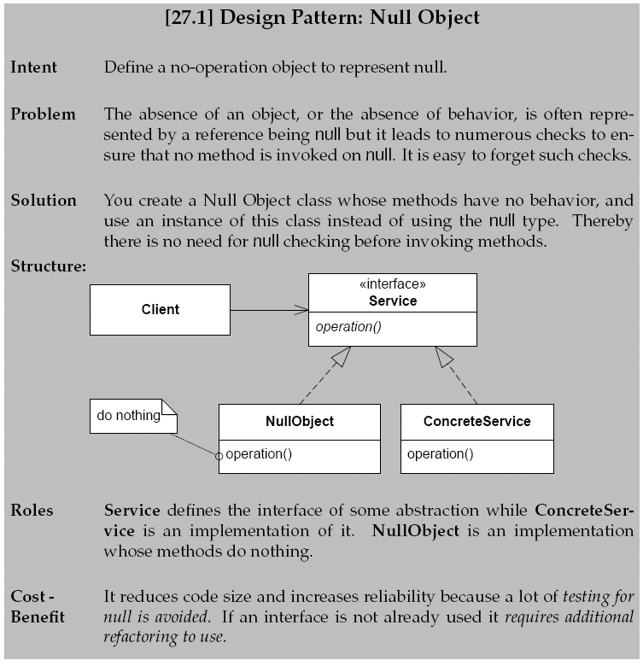
CS, AU
Henrik Bærbak Christensen

